Slide 1


GROUP 2
AML PROJECT DELIVERABLE 2
CREDIT SCORE CLASSIFICATION
GOKUL NATESAN, MADHULIKA BALAKUMAR, SHUMAIL SAJJAD, YASH DANGE

Slide 2

CONTENT
01
INITIAL DATA EXPLORATION
02
CLEANING AND SAMPLING
03
INSIGHTS FROM DATA EXPLORATION
04
MACHINE LEARNING TECHNIQUES PROPOSED

Slide 3

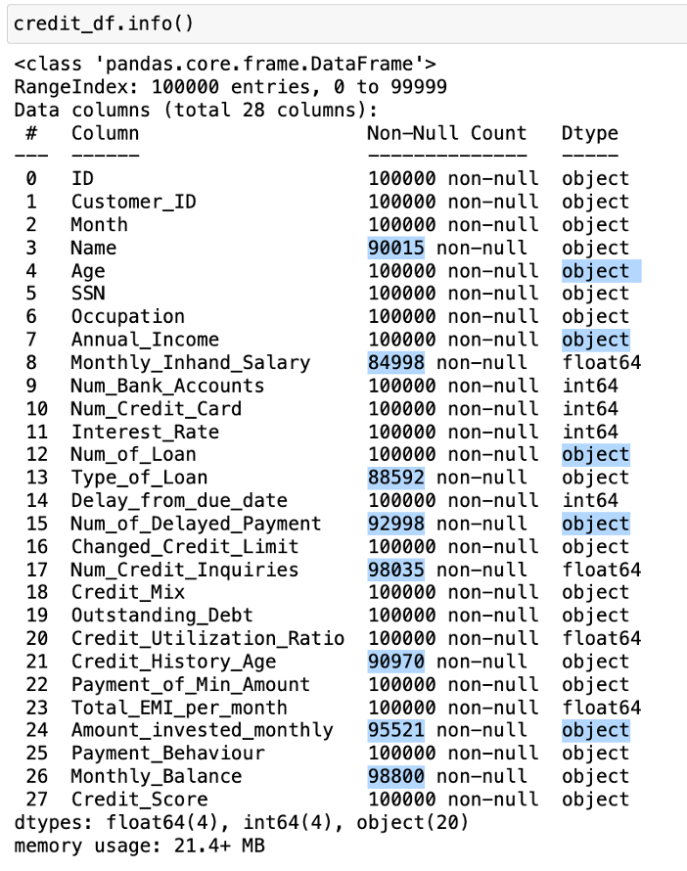
INITIAL DATA EXPLORATION
At a glance:
By simply taking a look at some basic summary information about the data, we can identify various issues that need to be addressed about the data, before it is ready to be trained using a model.
NUMBER OF ROWS: 100,000
NUMBER OF COLUMNS: 28
TARGET COLUMN: CREDIT SCORE

Slide 4

As highlighted, there are various issues about the data at hand such as:
a. Many columns have certain missing values. The dataset has 1,00,000 total rows but the number of non-null counts in columns like Name, Monthly salary, Loan Type, etc. are less than that. We need to address that.
b. The datatype for numerical columns like ‘Age’, ‘Annual Income’ should not be object. We need to convert it to a numerical datatype like floar or int, whichever is more suitable.
There are various issues that could arise if we don’t do this. For instance, if we calculate the summary statistics of the dataframe using the ‘describe’ function in pandas, we will not be able to see the stats for columns like Age, Income etc, despite the fact that they are numerical.

Slide 5
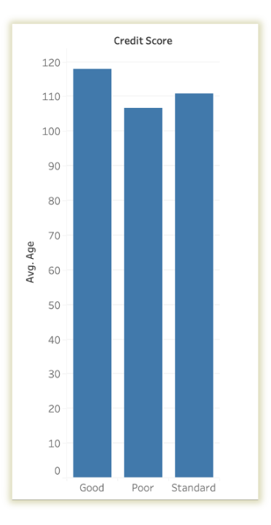
AGE VS CREDIT SCORE
In the graph (drawn using Tableau), we can see that the average age for all three classes of credit score is well over 100 years. This is certainly not consistent with expected values and indicates that outliers exist within the ‘Age’ column.
Note: This graph was made possible by Tableau which could identify Age as a numerical column and ignored the ‘_’ (underscore) actually present in some instances in the data.

Slide 6
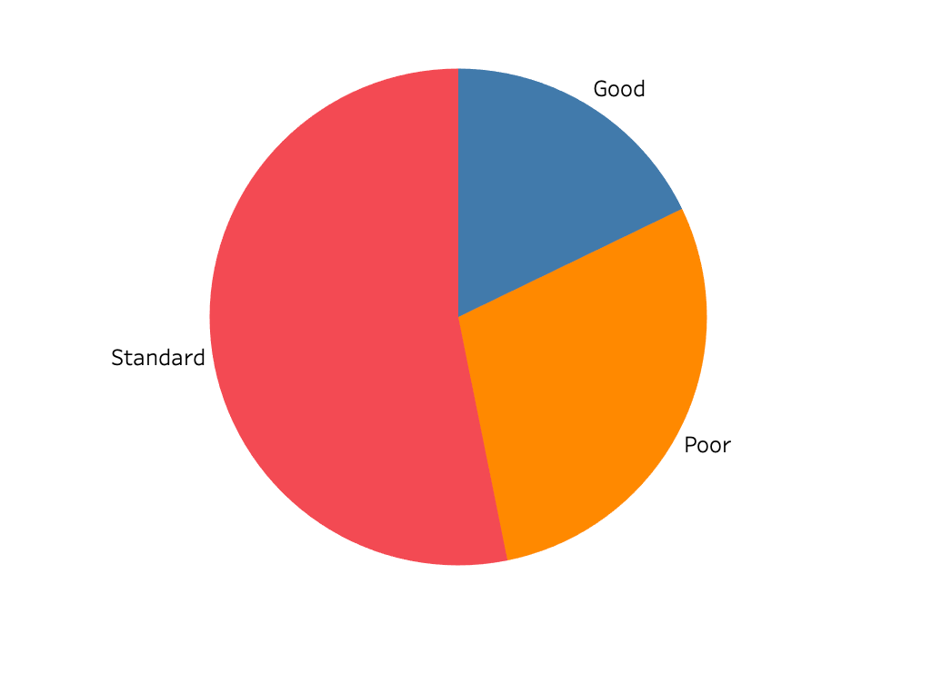
CLASS BALANCE: CREDIT SCORE
As shown in the figure, there are three possible classes for the target Column, viz. Standard, Poor, and Good. It can be seen that a majority of the class values are Standard, and Good or Poor labels are comparatively less. Since there are relatively good number of representations of each class interval, we can say the dataset is balanced.
Note: Since we have three classes in the target column, we will be doing either of ‘One vs One’ or ‘One vs Many’ approach while model training.

Slide 7
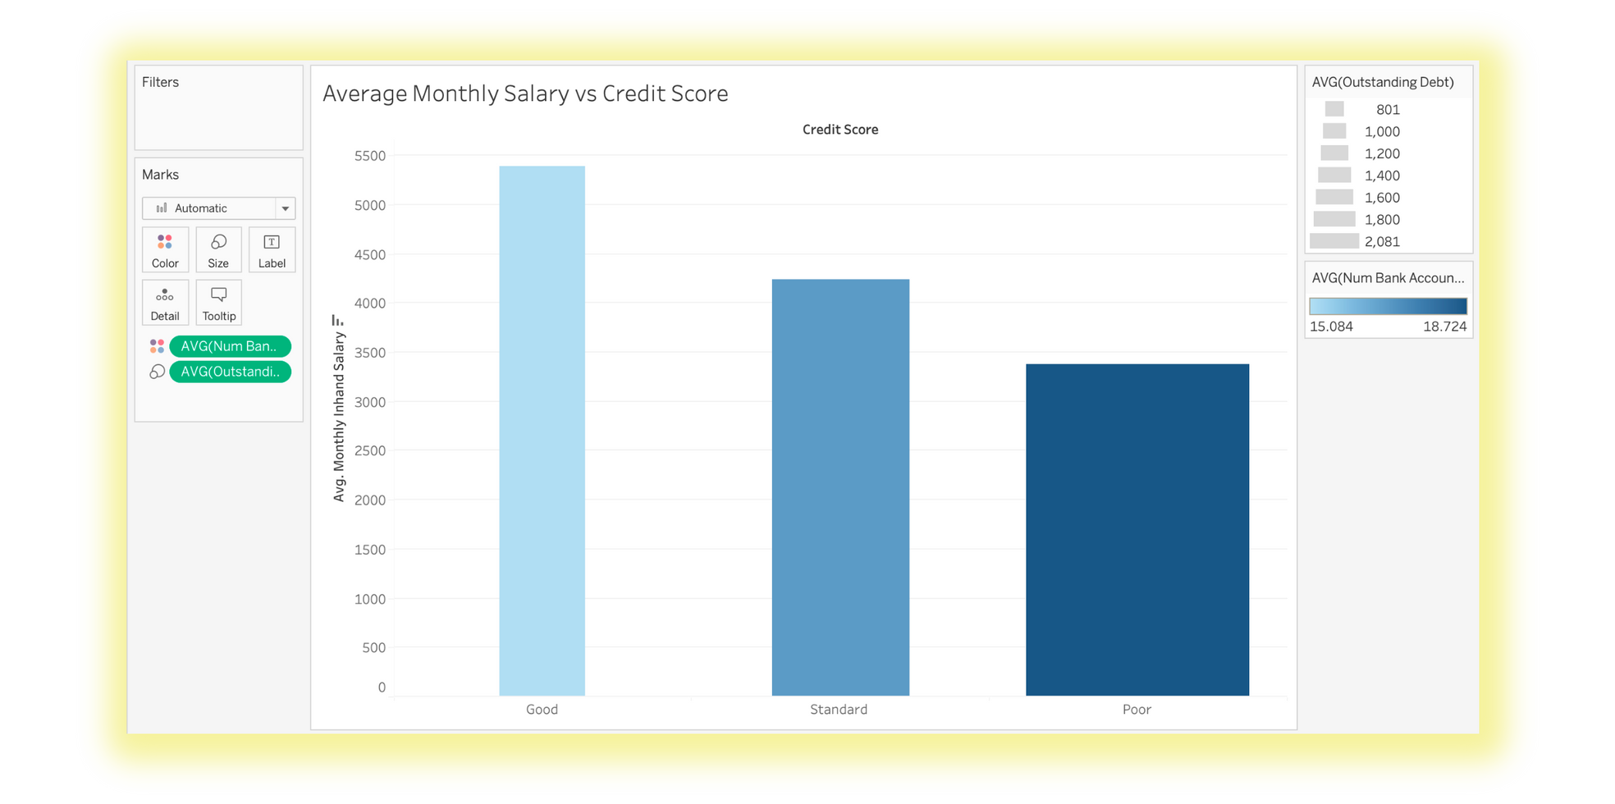
AVG. MONTHLY SALARY VS CREDIT SCORE
Note: Plot drawn on data before preprocessing

Slide 8
In the previous graph, which a bit more advanced, packs a lot more information about the target column by using attributes such as size, and colour to portray information.
Apart from the basic bar graph which shows that the people with the highest montly income have the most representation in ‘Good’ credit score class, it can be noted that the size of all bars is not the same, We have displayed additional information about the average outstanding debt of all customers in each class using this attribute. Lesser width of the bar indicates higher debt, which is naturally seen among people with a poor credit score.
Finally using colour, we have displayed the average number of bank accounts the customer holds. Again, smaller the better. The same trend is reflected here as well, with people in the poor category showing the darkest shade of blue, indicating the most accounts.

Slide 9

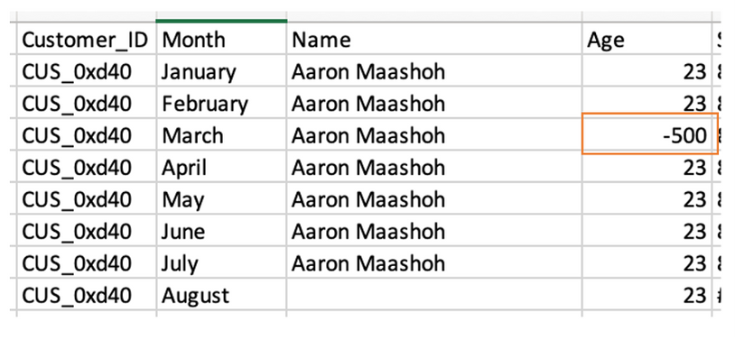
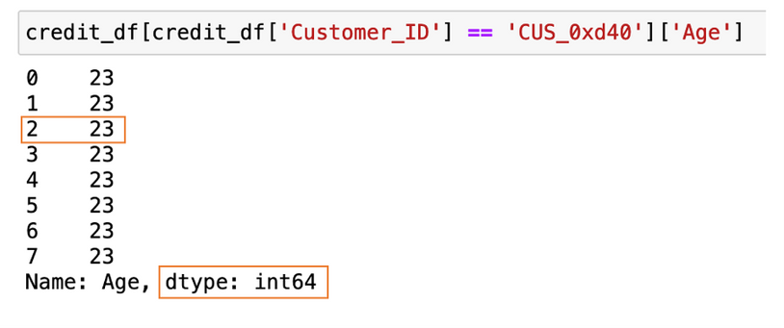
2. CLEANING AND SAMPLING
Age Column
Upon a brief observation of the data, we notice that there are misplaced underscores ‘_’ occasionally, the datatype is ‘object’ and some absurdly high values of age (5000) are present. Hence, we will fix this by
1. Eliminating the underscore
2. Converting the datatype to integer
3. Replacing ‘abnormal’ age values (here assumed to be under 10 and over 70) by corresponding age values of other columns with same customer ID and a ‘normal’ age value.
Before
After

Slide 10
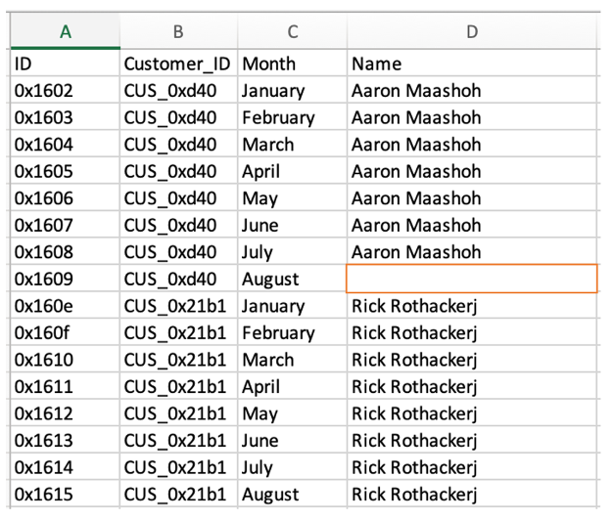
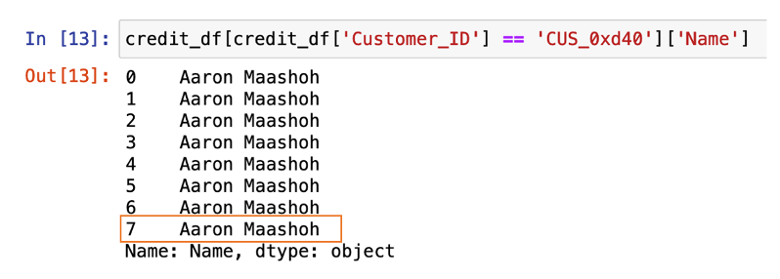
Before
After
Name Column
Note: There’s actually no need to handle missing values in columns such as ‘Name’ since we will eventually drop it during the model training stages. However, this data presents us with a unique opportunity to handle these values by using the corresponding customer-id associated with every name, and hence we have implemented it. Using such techniques can help us learn different ways in which missing values can be handled depending on the data - apart from traditional methods like dropping values of interpolation.

Slide 11
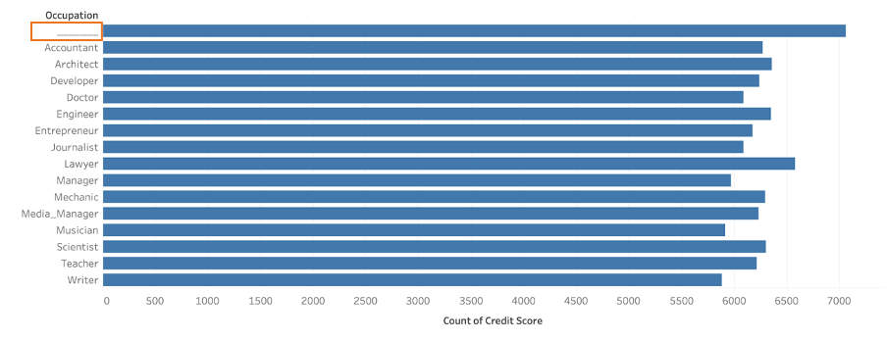
OCCUPATION COLUMN
Upon observing various plots in Tableau, we noticed that in the occupation vs target column (credit score) graph, there was an anomaly. An occupation that just had ‘_________’ mentioned in it.

Slide 12
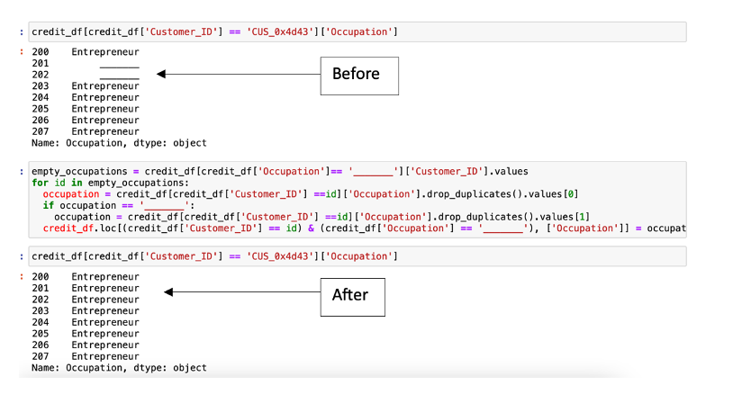
Similar to above techniques, we can simply replace occupation of '______' with the correct occupation of the applicant by looking up the corresponding customer_id
Important thing to note here is that: even though all seemed fine about the occupation column in the initial data.info part (no missing values, datatype was categorical as expected), there were certain issues with the data. Unlike the Name column which couldn’t have any influence on our target column, the occupation might be an important feature and thereby needs to be cleaned properly. This goes to show that data cleaning should be done carefully and scrupulously.

Slide 13
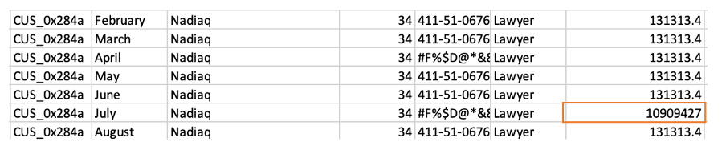
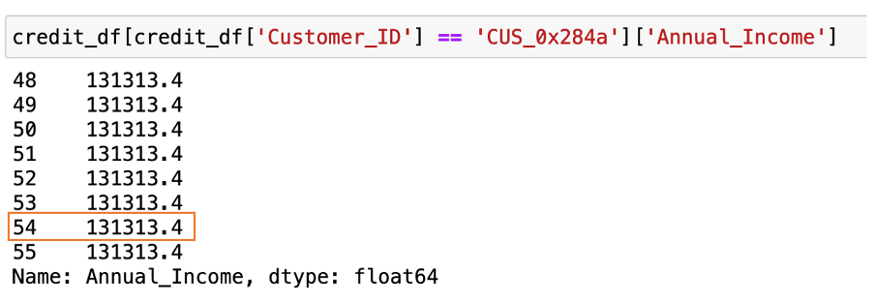
Annual Income
Similar to previous cases, the annual income column has two issues. A. ‘_’ present on certain intervals, B. Object datatype, C. Presence of outliers.
After handling underscores and converting the datatype, we handled the outliers by using the correct annual income from the corresponding customer_id, as shown in previous cases.
Before
After

Slide 14
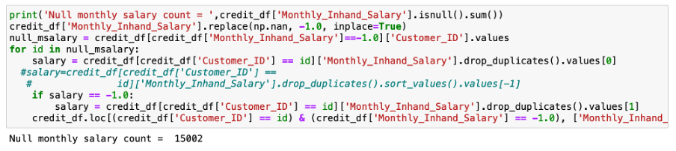
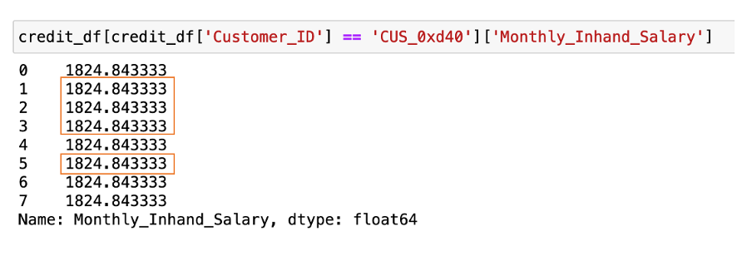
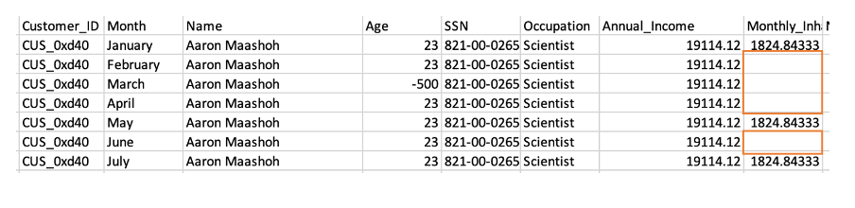
Monhtly Inhand Salary
As we saw in the data.info( ) section, there are missing values in this columns. Precisely, 15002 values are missing. We first assign a dummy value, ‘-1’ to all these missing values and then replace it with corresponding salary values of its customer id. The same process has been shown below:
Before
After

Slide 15
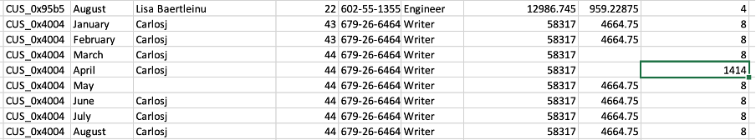
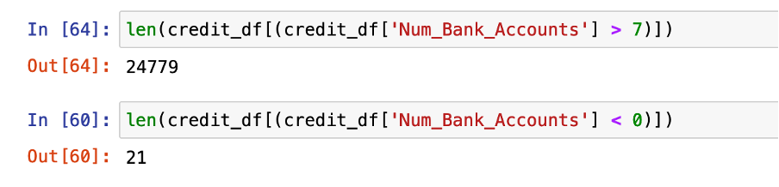
Number of bank Accounts:
Entries in this dataset consist of people with an usual amount of bank accounts.
For example, a person in the list below holds 1414 according to one entry and 8 according to all ither entries. This is clearly an error which would massively impact the model if not treated.
We will thus adjust all entries where bank accounts are more than 11 or less than 0 (summary data shows there are negative values too).

Slide 16
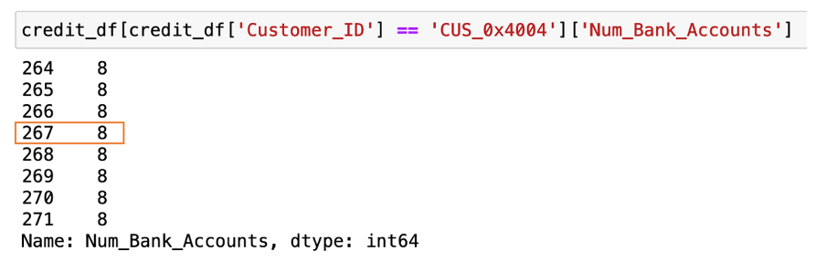
After this, the values of the previous customer have now been adjusted as shown:
Similar processing techniques were applied to remaining columns like Number of Credit cards, Interest rates, Number of loans, etc.

Slide 17
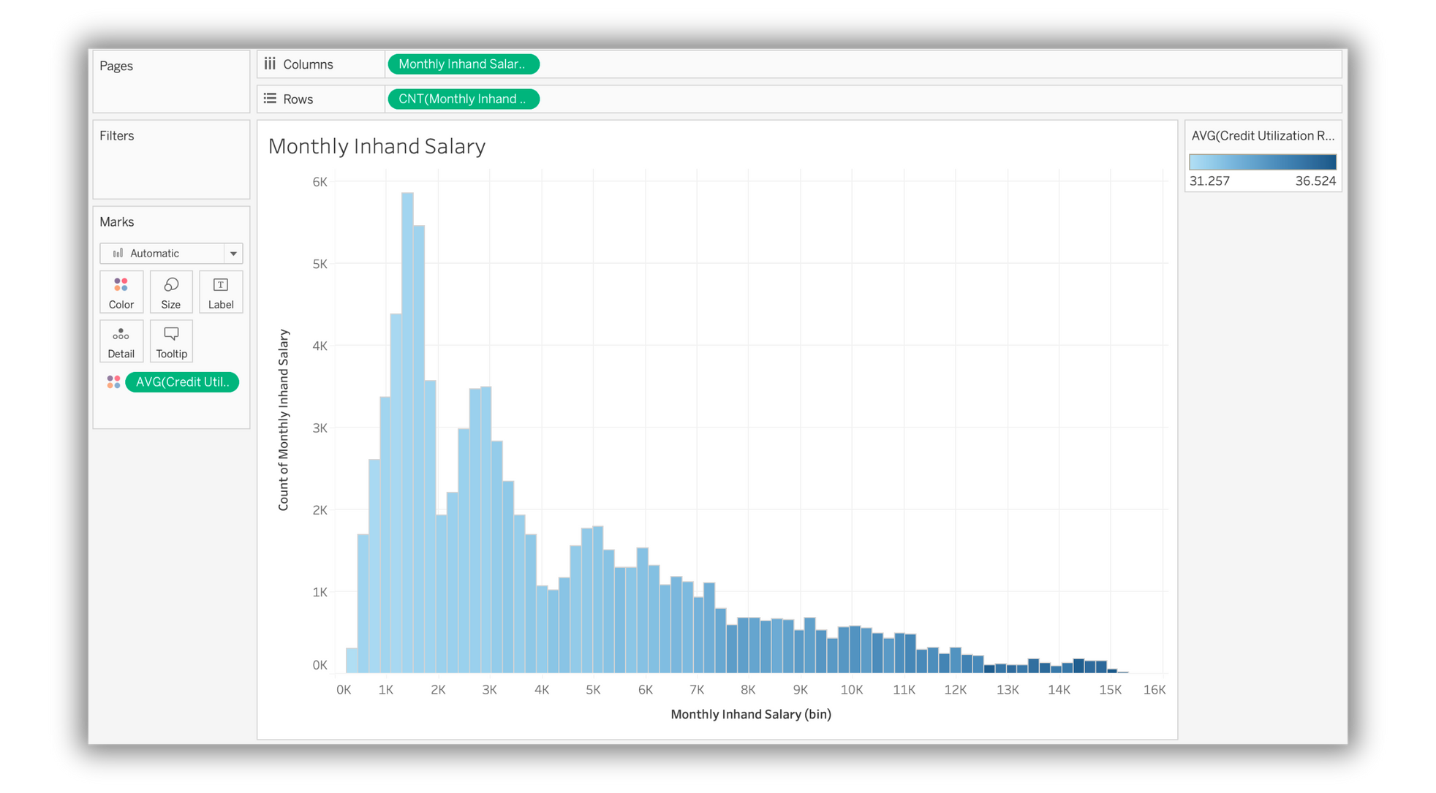
3. INSIGHTS FROM DATA EXPLORATION
In this section, we will try to understand dependance or general trend of individual columns and the target column, and also check how these columns are correlated with each other.

Slide 18
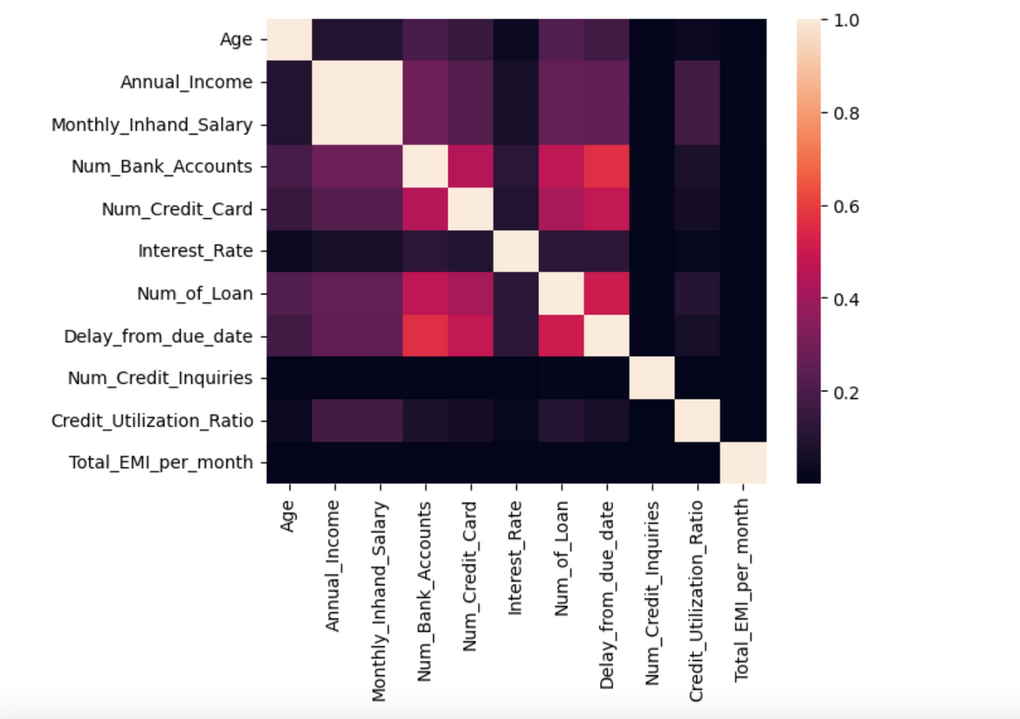
In the first graph, we plotted the frequency plot of ‘monthly in hand’ salaries of the people in the dataset. We have added the average credit utilisation ratio (in %) as a colour attribute. We can see that the data is skewed towards the left, suggesting that most people make about ~10K a month or less. People with higher income also seem to have a higher utilisation ratio of their credit line.
In this correlation plot, we can see how the independent variables are associated with each other.
As expected, Annual Income and Monthly inhand salary are almost perfectly positively correlated.
Credit Utilization Ratio is also stronly correlated with the income value.
Number of loans taken, Number of credit cards and number of bank accounts are also correlated, which is no surprise since having multiple loans at the same bank is unlikely.

Slide 19
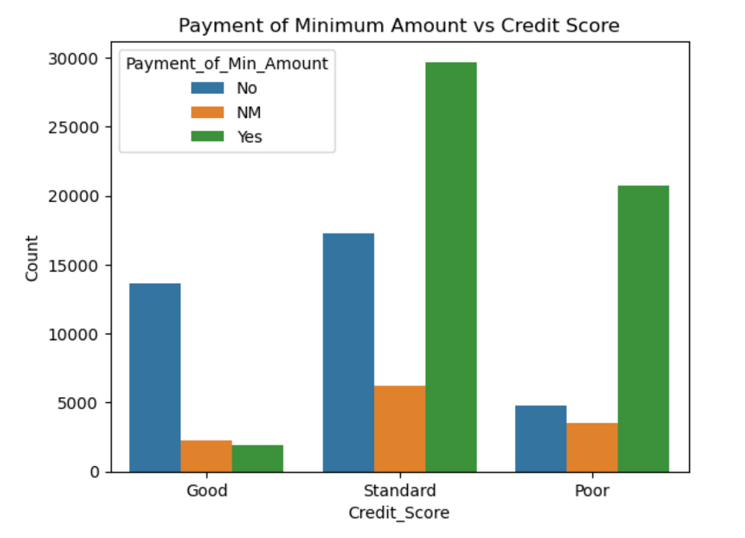
Here, we have seen the distribution of people who only paid the minimum amount due in each class of the target column. As seen, in the ‘Good’ class, majority of people did not pay just the minimum amount due, but the full amount. In the poor class, this number is significantly higher and most people only paid the minimum amount. For standard, again, almost twice as many people only paid the minimum amount than the ones who paid potentially more than that. This goes to show that it is preferred to pay the entire amount for a good score rating, but it is not the only matric that matters.

Slide 20
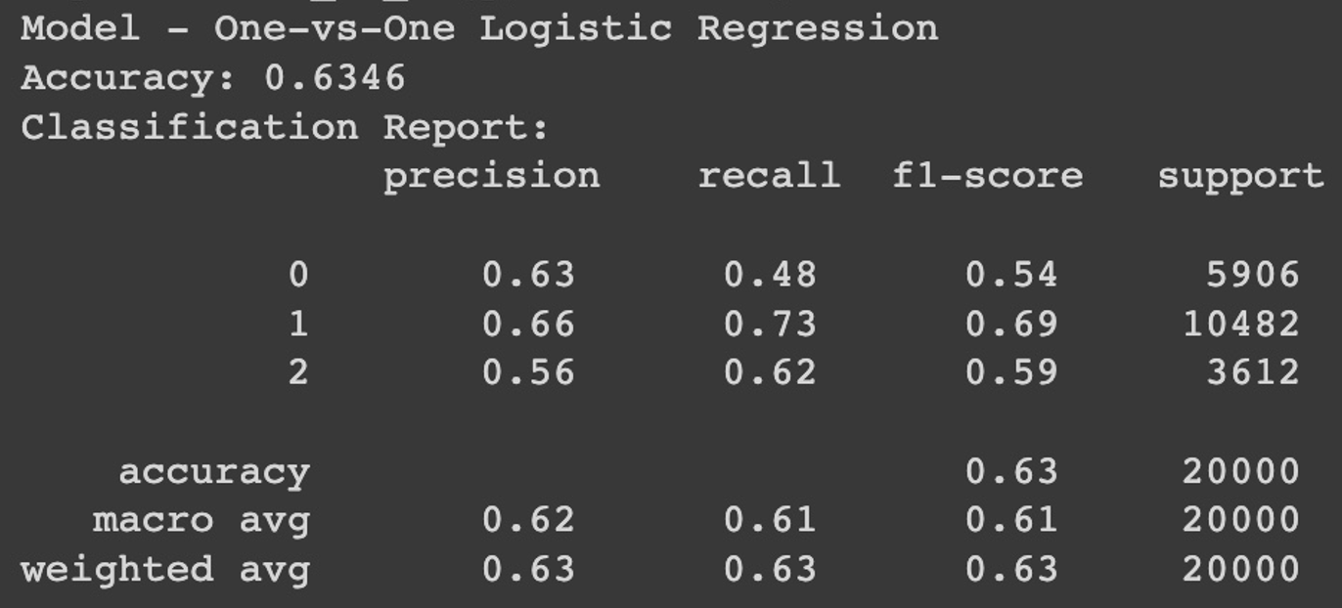
4. MACHINE LEARNING TECHNIQUES
Since our dataset had multiple entries for each customer ID and almost the same demographic and income information across entries for customers, we used a custom splitter to group data by ‘Customer_ID’ and did a stratified split based on the target class.
We have applied a standard scaler to the dataset as models like Logistic Regression and SVM require this preprocessing step
Multiclass One-vs-One Logistic Regression model with default parameters:

Slide 21
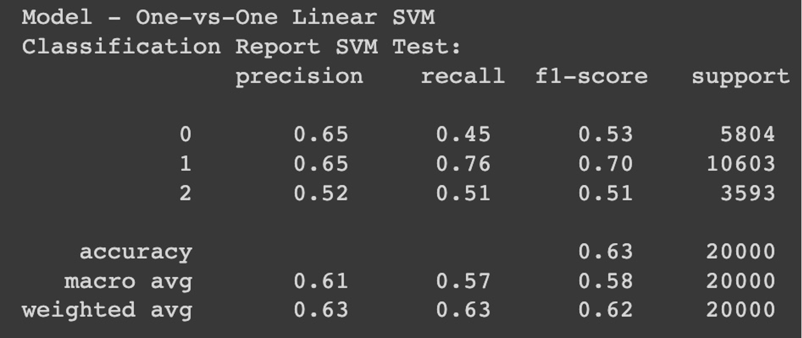
Multiclass One-vs-One SVM Primal model:

Slide 22
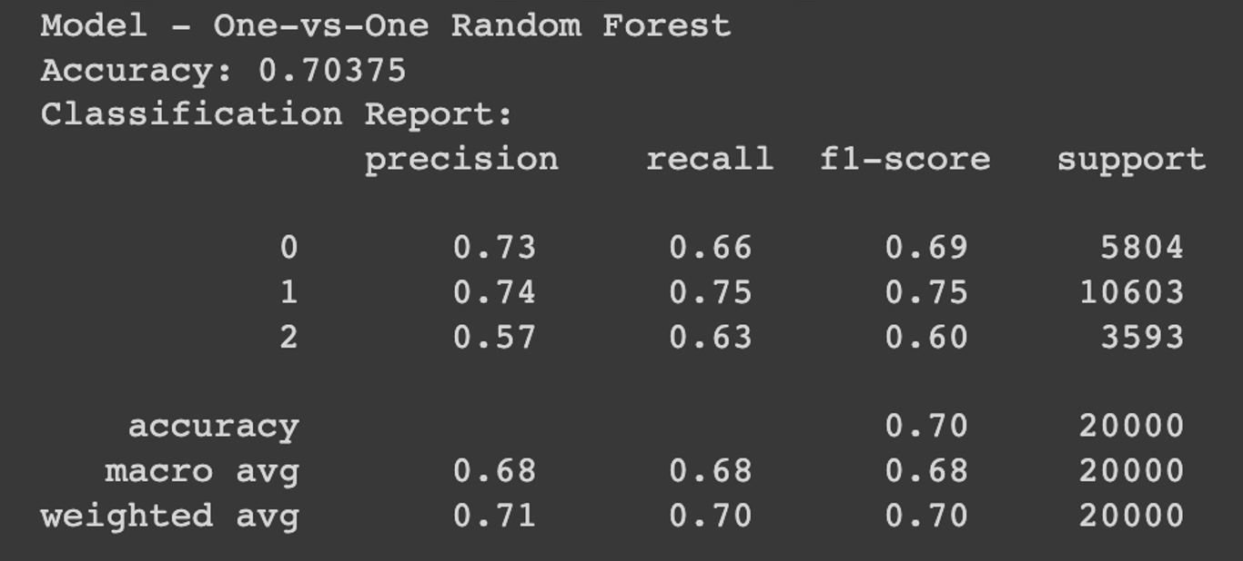
Multiclass One-vs-One SVM Random Forest model:

Slide 23
CONCLUSION
This presentation has taken us through initial data exploration, data cleaning, and insightful discoveries. Our path forward includes rigorous model testing, hyperparameter tuning, and model calibration. In coming weeks, we aim to find the optimal model, enhancing decision-making and uncovering opportunities. Thank you!

